Slide 1
Spring IOC & DI

Slide 2
Introduction to Spring
  Spring Framework:-
    Light-weight framework for the development of enterprise
    application.
      Spring deals with plumbing
      So you can focus on solving the domain problems
    Spring is an open source framework created to address the complexity of enterprise application development.
    One of the main advantages of the Spring framework is its layered architecture, which allows you to be selective about which of its components you use while also providing a consistent framework for J2EE application development.
    Address end-to-end requirements rather than one tier
    Facilitate OO best practice
    Founded on POJO-based development
      Ordinary Java classes that follow no special APIs

Slide 3
Introduction to Spring
A lightweight non-intrusive framework which addresses various tiers in a J2EE application.
    Application code has minimal or no dependency on Spring APIs
    More power to the POJO
  Presentation layer: Spring MVC
  Business layer: Lightweight IoC container with support for AOP-driven interceptors and transaction.
  Persistence layer – DAO template support for Hibernate, IBATIS and JDBC
Substantially reduces code, speeds up development and improves code quality.

Slide 4
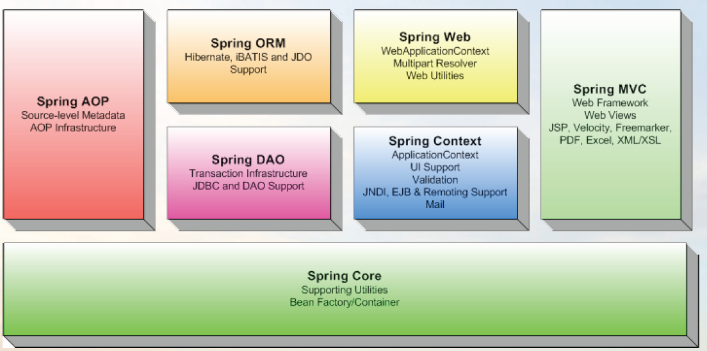
Spring Components

Slide 5
A layered framework
  Spring Core
    is the most import component of the Spring Framework.
    provides the Dependency Injection features.
    Module contains BeanFactory, which is the fundamental
    Spring container
  Spring Context
    Built on the core container.
    Extends the concept of BeanFactory , adding support for internalization, email, remoting and scheduling.
  Spring DAO
    The DAO (Data Access Object) support in Spring is primarily for standardizing the data access work by abstracting the biolerplate code.
    The Spring DAO module provides a JDBC-abstraction layer that reduces the need to do tedious JDBC coding and parsing of database-vendor specific error codes.

Slide 6
A layered framework
  Spring AOP
    Allowing cross cutting concerns such as transaction management to be woven into beans as “aspects” rather than becoming the concern of the business object.
  Spring ORM
    Spring’s ORM supports on the DAO support ,providing a convenient way to build DAO’s for several ORM solutions.
    Spring provide support to various ORM frameworks including Hibernate,iBATIS.
  Spring MVC
    Spring MVC is a commonly accepted approach to build web application such that the user interface is separate from the application logic
  Spring Web
    The Web context module provides basic web-oriented integration features builds on top of the application context module, providing contexts for Web-based applications. As a result, the Spring framework supports integration with Jakarta Struts.

Slide 7
Basics - containers and beans
In Spring, those objects that form the backbone of your application and that are managed by the Spring IoC container are referred to as beans. A bean is simply an object that is instantiated, assembled and otherwise managed by a Spring IoC container.
These beans, and the dependencies between them, are reflected in the configuration metadata used by a container.
The org.springframework.beans.factory.BeanFactory is the actual representation of the Spring IoC container that is responsible for containing and otherwise managing the beans.
The BeanFactory interface is the central IoC container interface in Spring. Its responsibilities include instantiating or sourcing application objects, configuring such objects, and assembling the dependencies between these objects.

Slide 8
Beans and Container

Slide 9

Basics - containers and beans
The Spring IoC container
Spring IoC container consumes some form of configuration metadata; this configuration metadata is to inform the Spring container as to how to “instantiate, configure, and assemble [the objects in your application]”. This configuration metadata is typically supplied in a simple and intuitive XML format.

Slide 10
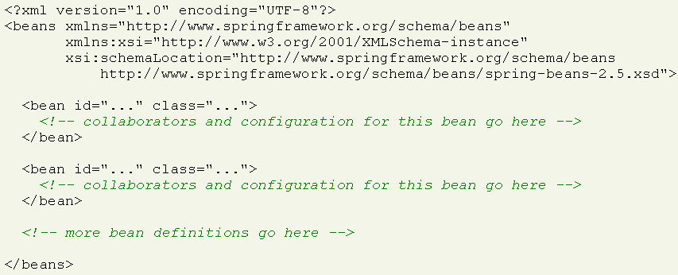
Configuration metadata
Find below an example of the basic structure of XML-based configuration metadata.

Slide 11
Spring Bean Container
Types of Bean Containers:
  Bean Factory
    Provides basic support for dependency injection
    Configuration and lifecycle management
  Application Context
    Builds on Bean Factory and adds services for:
      Resolving messages from properties files for
      internationalization,
      Mail
      Scheduling

Slide 12
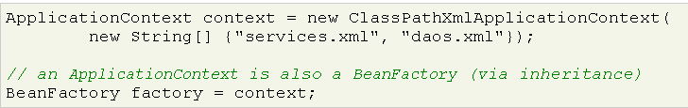
Instantiating a Container
BeanFactory enables you to read bean definitions and access them using the bean factory. When using just the BeanFactory you would create one and read in some bean definitions in the XML format as follows:

Slide 13
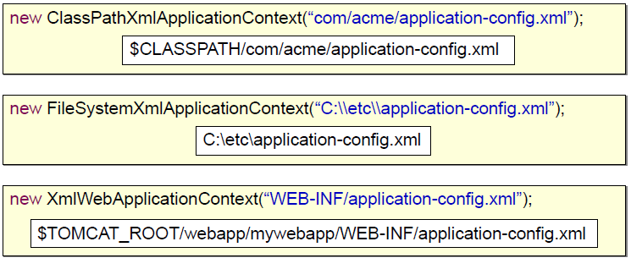
Instantiating a Container
ClassPathXmlApplicationContext - Loads the XML file located in the classpath
FileSystemXmlApplicationContext -Loads the XML file located in the file system
XmlWebApplicationContext -Loads the XML file contained within a web application

Slide 14
BeanFactory or ApplicationContext?
As the ApplicationContext includes all functionality of the BeanFactory, it is generally recommended that it be used in preference to the BeanFactory, except for a few limited situations such as in an Applet, where memory consumption might be critical and a few extra kilobytes might make a difference.
Using just a plain BeanFactory then a fair amount of support such as transactions and AOP will not take effect
Bean Factory : Beans are lazily loaded , the beans will not be instantiated until they are needed. To retrieve the bean from BeanFactory call the getBean() method , passing the Id of the bean you want to retrieve.
MyBean myBean = (MyBean) factory.getBean(“myBean”);
ApplicationContext preloads all the singleton beans upon context startup

Slide 15
Bean Name
Uses
  – Identify bean collaborators when defining Spring beans
  – Identify beans to be accessed programmatically from the
  Spring IoC container using the BeanFactory API
• Configuration
  – XML bean attribute id
    • W3C XML Schema datatype ID
    • Accepts a single value
  – XML bean attribute name
    • One or more values delimited by comma, semicolon, or space

Slide 16
Bean Name
<bean id="beanId"
  name="beanName01,beanName02;beanName03 beanName04“ class="uhg.Bean"/>
beanFactory.getBean("beanId");
beanFactory.getBean("beanName01");
beanFactory.getBean("beanName02");
beanFactory.getBean("beanName03");
beanFactory.getBean("beanName04");

Slide 17
Bean naming conventions
The convention (at least amongst the Spring development team) is to use the standard Java convention for instance field names when naming beans.
bean names start with a lowercase letter, and are camel-cased from then on.
Examples of such names would be (without quotes) 'accountManager', 'accountService', 'userDao', 'loginController', and so forth.

Slide 18
Bean scopes
You can the scope of the objects created from a particular bean definition.
When a bean is a singleton, only one shared instance of the bean will be managed, and all requests for beans with an id or ids matching that bean definition will result in that one specific bean instance being returned by the Spring container.
The singleton scope is the default scope in Spring. To define a bean as a singleton in XML, you would write configuration like so:

Slide 19
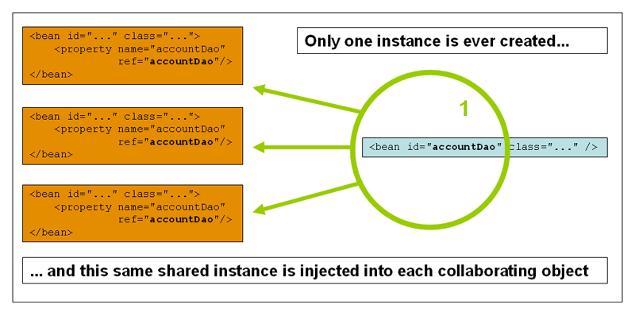
Bean Scope - Singleton
To define a bean as a singleton in XML, you would write configuration like so:

Slide 20
Bean Scope : Prototype
The non-singleton, prototype scope of bean deployment results in the creation of a new bean instance every time a request for that specific bean is made.
The following diagram illustrates the Spring prototype scope. Please note that a DAO would not typically be configured as a prototype, since a typical DAO would not hold any conversational state

Slide 21
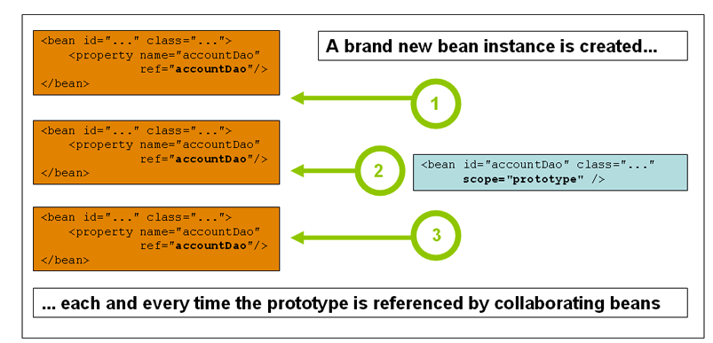
Bean Scope : Prototype
To define a bean as a prototype in XML, you would write configuration like so:

Slide 22
Spring Hello World

Slide 23
Spring Hello World
Code a plain Java class model
  – Use the interface pattern by coding a HelloWorld interface and a HelloWorldImpl implementation
• Configure the Spring IoC container
• Instantiate the Spring IoC container
• Acquire the object from the Spring IoC Container

Slide 24
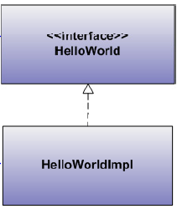
Plain Java Class Model
public interface HelloWorld {
public void execute();
}
public class HelloWorldImpl
implements HelloWorld {
public void execute() {
System.out.println("Hello World!");
}
}

Slide 25
Spring IoC Configuration
<?xml version="1.0" encoding="UTF-8"?>
<beans xmlns="http://www.springframework.org/schema/beans"
xmlns:xsi="http://www.w3.org/2001/XMLSchema-instance"
xsi:schemaLocation="http://www.springframework.org/schema/beans
http://www.springframework.org/schema/beans/spring-beans-2.5.xsd">
<bean id="helloWorld"
class="com.uhg.helloworld.HelloWorldImpl" />
</beans>

Slide 26
Executing Spring Hello World
import org.springframework.beans.factory.*;
import org.springframework.context.support.*;
public class Main{
  public static void main(String[] args) {
  ApplicationContext context = new ClassPathXmlApplicationContext(
  "applicationContext.xml");
  HelloWorld helloWorld =(HelloWorld) context .getBean("helloWorld");
  helloWorld.execute();
  }
}

Slide 27
Dependency Injection

Slide 28
Dependency Injection
It is at the heart of the Spring framework.
Instead of objects invoking other objects, the dependant objects are added through an container.
The basic concept of dependency injection is that you do not create your objects but describe how they should be created.
You don't directly connect your components and services together in code but describe which services are needed by which components in a configuration file.
A container (in the case of the Spring framework, the IOC container) is then responsible for wiring it all up.
Prevents hard-coded object creation Loose coupling
DI exists in two major variants, namely Constructor Injection and Setter Injection.

Slide 29
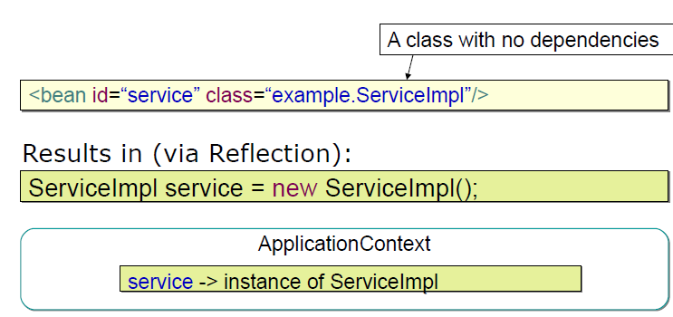
Simplest Possible Bean Definition

Slide 30
Setter Injection

Slide 31
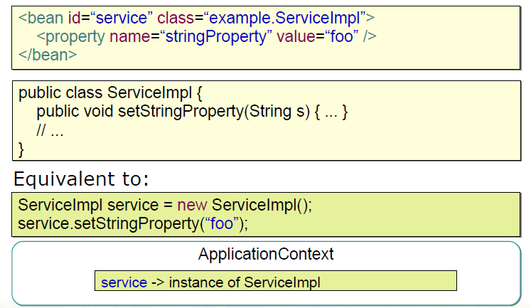
Injecting Scalar Values

Slide 32
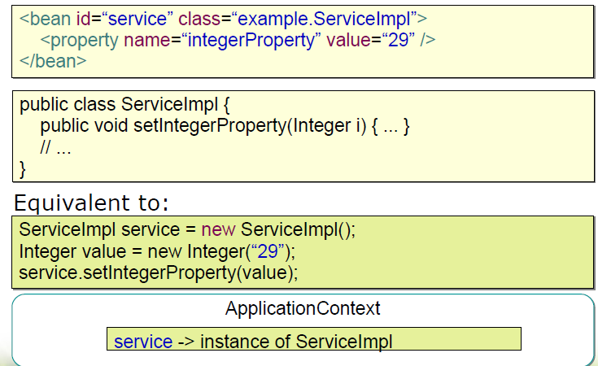
Automatic Value type conversion

Slide 33
References to other beans (collaborators)
The ref element is the element allowed inside a <constructor-arg/> or <property/> definition element.
It is used to set the value of the specified property to be a reference to another bean managed by the container.
As mentioned in a previous section, the referred-to bean is considered to be a dependency of the bean who's property is being set, and will be initialized.

Slide 34
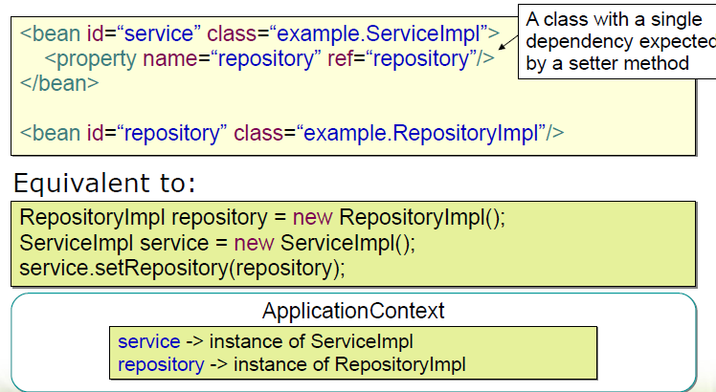
Setter Dependency Injection

Slide 35
Constructor Injection

Slide 36
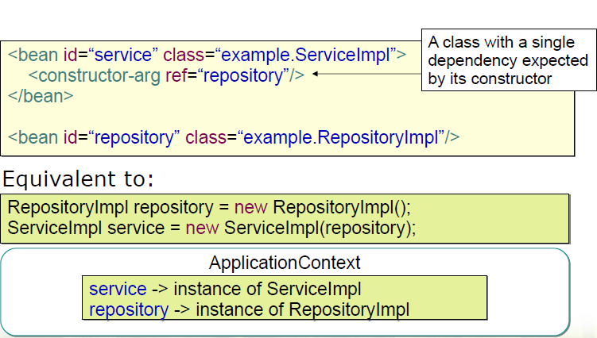
Constructor Dependency Injection

Slide 37
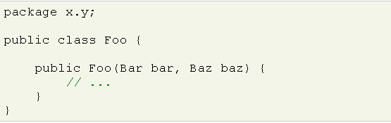
Constructor Argument Resolution
There is no potential for ambiguity in the constructor arguments of a bean definition, then the order in which the constructor arguments are defined in a bean definition is the order in which those arguments will be supplied to the appropriate constructor when it is being instantiated. Consider the following class:
There is no potential for ambiguity here. Thus the following configuration will work just fine, and you do not need to specify the constructor argument indexes and / or types explicitly.

Slide 38
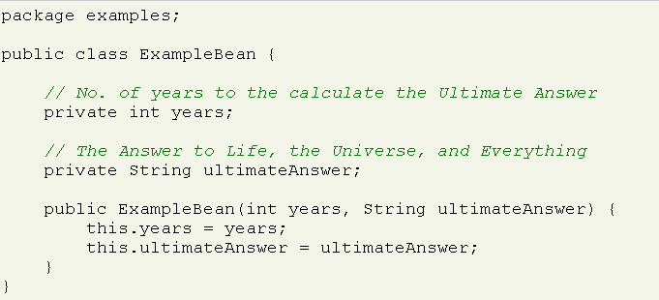
Constructor Argument Resolution
When a simple type is used, such as <value>true<value>, Spring cannot determine the type of the value, and so cannot match by type without help. Consider the following class:
The above scenario can use type matching with simple types by explicitly specifying the type of the constructor argument using the 'type' attribute. For example:

Slide 39

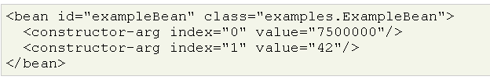
Constructor Argument Type Matching And Argument Index
Constructor Argument Index
Constructor arguments can have their index specified explicitly by use of the index attribute. For example:

Slide 40
Constructor vs Setter Injection
Constructor injection enforces a strong dependency contract. In short, a bean cannot be instantiated without being given all of its dependencies.
By only allowing properties to be set through the constructor, you are, effectively, making those properties immutable.
If there are several ways to construct a valid object, it can be hard to come up with unique constructors, since constructor signatures vary only by the number and type of parameters.
.
Spring doesn’t take sides in this debate and let us choose the injection model that suits you best.

Slide 41
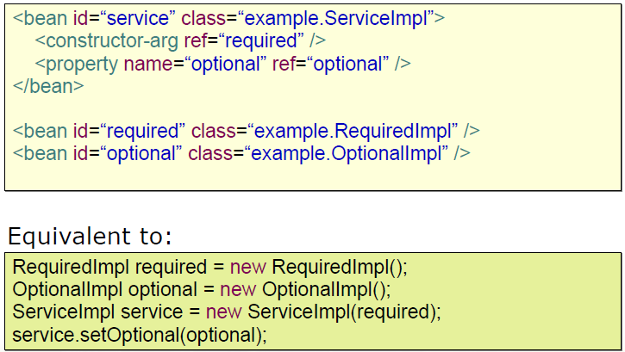
Combining Setter and Constructor

Slide 42
Defining Parent and Child Bean

Slide 43
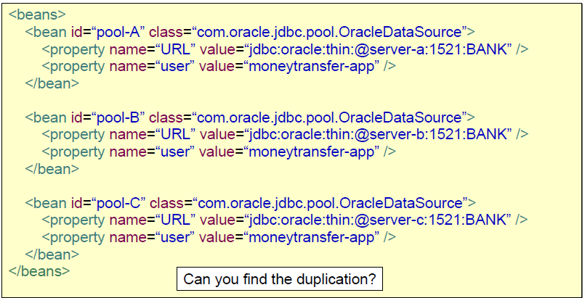
Without Bean Definition Inheritance

Slide 44
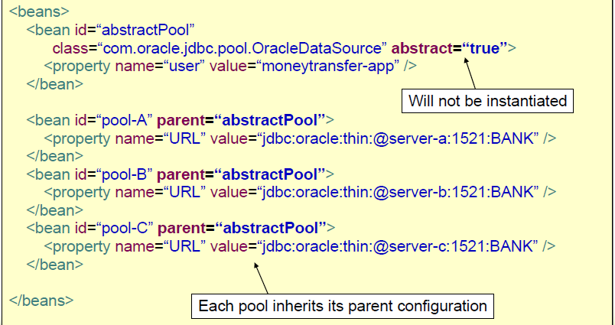
With Bean Definition Inheritance

Slide 45
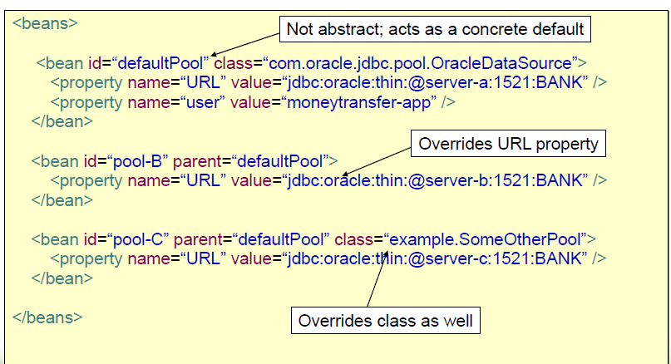
Overriding Parent Bean Configuration

Slide 46
Inner Bean

Slide 47
Inner Beans
  Sometimes a bean scopes the definition of another bean
    The scoped bean is not useful for another bean
  Make the Scoped bean an inner bean
    More Manageable
  A <bean/> element inside the <property/> or <constructor-arg/> elements is used to define a so-called inner bean.
  An inner bean definition does not need to have any id or name defined, and it is best not to even specify any id or name value because the id or name value simply will be ignored by the container.

Slide 48
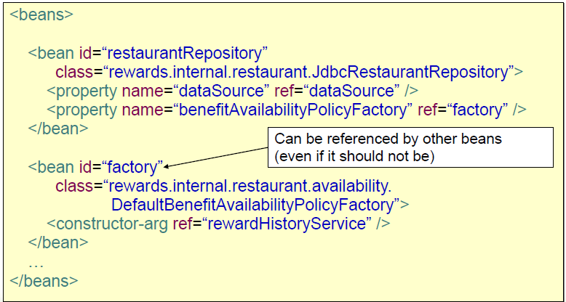
Without an Inner Bean

Slide 49
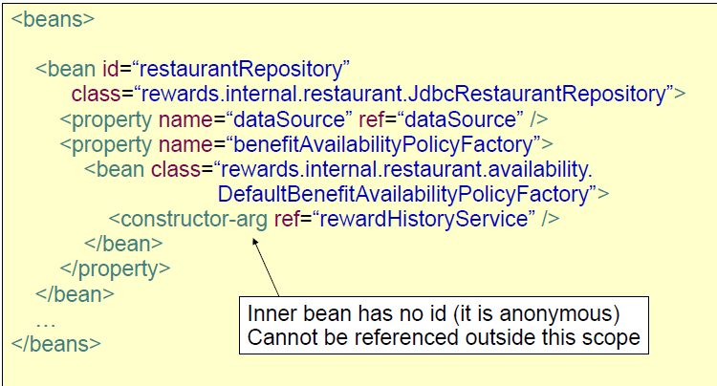
With an Inner Bean

Slide 50
Wiring Collection

Slide 51
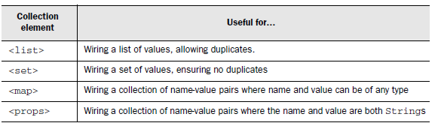
Wiring collections

Slide 52
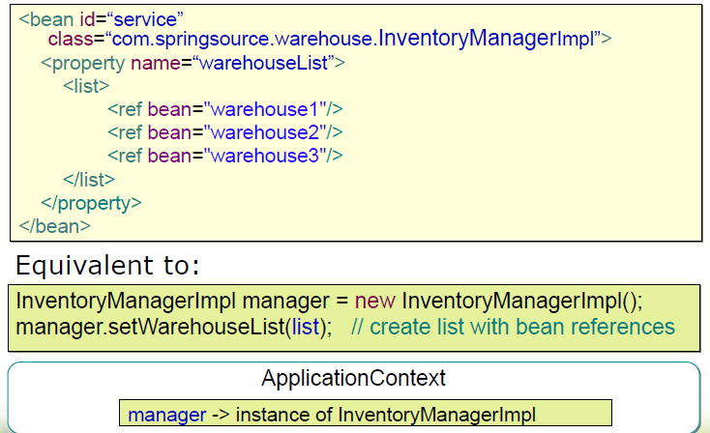
Injecting Lists

Slide 53
Injecting List
bean id="hank" class="com.springidol.OneManBand">
<property name="instruments">
<list>
<ref bean="guitar" />
<ref bean="cymbal" />
<ref bean="harmonica" />
</list>
</property>
</bean>

Slide 54
Injecting Sets
<set> ensures that each of its members is unique.
<bean id="hank" class="com.springidol.OneManBand">
<property name="instruments">
<set>
<ref bean="guitar" />
<ref bean="cymbal" />
<ref bean="harmonica" />
<ref bean="harmonica" />
</set>
</property>
</bean>
Hank has been given two references to harmonica. But because <set> is used to configure the instruments property, the extra harmonica is effectively ignored.

Slide 55
Injecting Maps
Instead, the following declaration of the hank bean uses the
<map> element to configure the instruments property:
<bean id="hank" class="com.springidol.OneManBand">
<property name="instruments">
<map>
<entry key="GUITAR" value-ref="guitar" />
<entry key="CYMBAL" value-ref="cymbal" />
<entry key="HARMONICA" value-ref="harmonica" />
</map>
</property>
</bean>

Slide 56
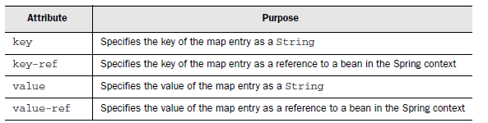
Injecting Maps
Although our example uses the key attribute to specify a String key and value-ref to specify a reference value.

Slide 57
Injecting Properties
The Properties class serves roughly the same purpose as Map,but limits the keys and values to Strings.
<bean id="hank" class="com..springidol.OneManBand">
<property name="instruments">
<props>
<prop key="GUITAR">STRUM STRUM STRUM</prop>
<prop key="CYMBAL">CRASH CRASH CRASH</prop>
<prop key="HARMONICA">HUM HUM HUM</prop>
</props>
</property>
</bean>

Slide 58
Multiple XML-based configuration metadata

Slide 59
<Import> element
It can often be useful to split up container definitions into multiple XML files. One way to then load an application context which is configured from all these XML fragments is to use the application context constructor which takes multiple Resource locations
An alternate approach is to use one or more occurrences of the <import/> element to load bean definitions from another file (or files). Let's look at a sample:

Slide 60
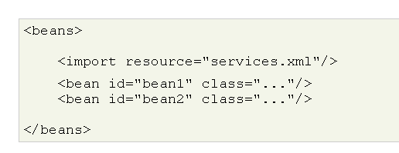
<Import> element
All location paths are considered relative to the definition file doing the importing, so services.xml in this case must be in the same directory or classpath location.

Slide 61
Creating beans from factory methods

Slide 62
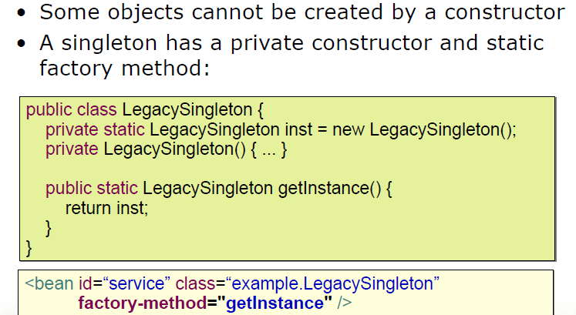
Singleton Pattern

Slide 63
Factory Pattern
A Factory Class exists to create and configure instances of other classes.
Instantiation using an instance factory method is where a non-static method of an existing bean from the container is invoked to create a new bean.
To use this mechanism, the 'class' attribute must be left empty, and the 'factory-bean' attribute must specify the name of a bean in the current container that contains the instance method that is to be invoked to create the object.
The name of the factory method itself must be set using the 'factory-method' attribute.

Slide 64
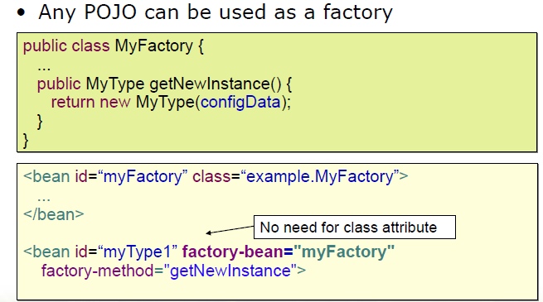
POJO as Factory Pattern

Slide 65
DI Alternative : Autowiring

Slide 66
Autowiring
We have seen how to wire all of your bean’s properties using either the
<constructor-arg> or the <property> element.
In a large application, however, all of this explicit wiring can result in a lot of XML.
Spring automatically figure out how to wire beans together by setting the autowire property on each <bean> that you want Spring to autowire.

Slide 67
Types of Autowiring
Spring provides four flavors of autowiring:
byName—Attempts to find a bean in the container whose name (or ID) is the same as the name of the property being wired.
byType—Attempts to find a single bean in the container whose type matches the type of the property being wired.
Constructor -This is analogous to byType, but applies to constructor arguments.
autodetect - Chooses constructor first and then byType

Slide 68
Autowire by Name
<bean id="kenny"
class="com.springidol.Instrumentalist">
<property name="song" value="Jingle Bells" />
<property name="instrument" ref="saxophone" />
</bean>
Here we’ve explicitly configured Kenny’s instrument property using <property>.
We declared the Saxophone as a <bean>
with an id of instrument
<bean id="instrument"
class="com.springinaction.springidol.Saxophone" />

Slide 69
Autowire by Name
Spring can take advantage of this to automatically
configure Kenny’s instrument by setting the autowire property
as follows:
<bean id="kenny"
class="com.springidol.Instrumentalist"
autowire="byName">
<property name="song" value="Jingle Bells" />
</bean>
byName autowiring sets a convention where a property will
automatically be wired with a bean of the same name.

Slide 70
To autowire or not
However, there are other shortcomings associated with autowiring.
For example, suppose that an Instrumentalist bean is set to be autowired
using byName. As a result, its instrument property will automatically be set to
The bean in the container whose name is instrument. Let’s say that you
decide that you want to refactor the instrument property, renaming it as
musicalInstrument. After refactoring, the container will try to autowire by
looking for a bean named musicalInstrument. Unless you have changed the
bean XML file, it won’t find a bean by that name and will leave the property
unwired. When the Instrumentalist bean tries to use the musicalInstrument
property, you’ll get a NullPointer-Exception.
Worse still, what if there is a bean named musicalInstrument (not likely, but it could happen) but it isn’t the bean you want wired to the
musicalInstrument property? Depending on the type of the musicalInstrument bean, Spring may quietly wire in the unwanted bean, resulting in unexpected application behavior.
But the most serious shortcoming of autowiring is that it lacks clarity.

